Slide 1
Unit 4 : Data Warehousing Technologies and Implementation

Slide 2
Introduction
Incomplete, noisy, and inconsistent data are common place properties of large real-world databases and data warehouses.
Incomplete data can occur for a number of reasons.
Attributes of interest may not always be available, such as customer information for sales transaction data.
Other data may not be included simply because it was not considered important at the time of entry.
Relevant data may not be recorded due to a misunderstanding, or because of equipment malfunctions.
Data that were inconsistent with other recorded data may have been deleted.
Furthermore, the recording of the history or modifications to the data may have been overlooked.
Missing data, particularly for tuples with missing values for some attributes, may need to be inferred.

Slide 3
Extract, Transform and Load (ETL) Definition
Three separate functions combined into one development tool:
Extract - Reads data from a specified source and extracts a desired subset of data.
Transform - Uses rules or lookup tables, or creating combinations with other data, to convert source data to the desired state.
Load - Writes the resulting data to a target database

Slide 4
Furthermore, these tools and utilities include the following functions:
Data extraction, which typically gathers data from multiple, heterogeneous, and external sources
Data cleaning, which detects errors in the data and rectifies them when possible
Data transformation, which converts data from legacy or host format to warehouse format
Load, which sorts, summarizes, consolidates, computes views, checks integrity, and builds indices and partitions
Refresh, which propagates the updates from the data sources to the warehouse

Slide 5
ETL Overview
ETL, Short for extract, transform, and load are the database functions that are combined into one tool.
ETL is used to migrate data from one database to another, to form data marts and data warehouses and also to convert databases from one format or type to another.
To get data out of the source and load it into the data warehouse – simply a process of copying data from one database to other

Slide 6
ETL Overview
Data is extracted from an OLTP database, transformed to match the data warehouse schema and loaded into the data warehouse database
Many data warehouses also incorporate data from non-OLTP systems such as text files, legacy systems, and spreadsheets; such data also requires extraction, transformation, and loading.

Slide 7
The ETL Cycle
EXTRACT
The process of reading data from different sources.
TRANSFORM
The process of transforming the extracted data from its original state into a consistent state so that it can be placed into another database.
LOAD
The process of writing the data into the target source.

MIS Systems
(Acct, HR)
TRANSFORM
CLEANSE
Data Warehouse
www data
Legacy
Systems
EXTRACT
LOAD
Archived data

Other indigenous applications
(COBOL, VB, C++, Java)
OLAP
Temporary
Data storage

Slide 8
ETL Processing
ETL is independent yet interrelated steps.
It is important to look at the big picture.
Data acquisition time may include…
Extracts
from
source
systems
Data
Movement
Data
Transfor-
mation
Data
Cleansing
Data
Loading
Index
Mainte-
nance
Statistics
Collection
Backup
Back-up is a major task, it is a Data Warehouse not a cube

Slide 9
ETL is often a complex combination of process and technology that consumes a significant portion of the data warehouse development efforts and requires the skills of business analysts, database designers, and application developers
It is not a one time event as new data is added to the Data Warehouse periodically – i.e. monthly, daily, hourly
Because ETL is an integral, ongoing, and recurring part of a data warehouse. It may be:
Automated
Well documented
Easily changeable
When defining ETL for a data warehouse, it is important to think of ETL as a process, not a physical implementation

Slide 10
Extraction, Transformation, and Loading (ETL) Processes
Data Extraction
Data Cleansing
Data Transformation
Data Loading
Data Refreshing

Slide 11
Data Extraction

Slide 12
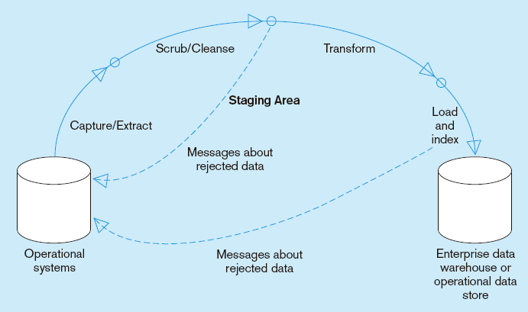
Capture/Extract…obtaining a snapshot of a chosen subset of the source data for loading into the data warehouse
Static extract = capturing a snapshot of the source data at a point in time
Incremental extract = capturing changes that have occurred since the last static extract

Slide 13
Data is extracted from heterogeneous data sources
Each data source has its distinct set of characteristics that need to be managed and integrated into the ETL system in order to effectively extract data.

Slide 14
ETL process needs to effectively integrate systems that have different:
DBMS
Operating Systems
Hardware
Communication protocols
Need to have a logical data map before the physical data can be transformed
The logical data map describes the relationship between the extreme starting points and the extreme ending points of your ETL system usually presented in a table or spreadsheet

Slide 15
Some ETL Tools
Tool | Vendor
Oracle Warehouse Builder (OWB) | Oracle
Data Integrator (BODI) | Business Objects
IBM Information Server (Ascential) | IBM
SAS Data Integration Studio | SAS Institute
PowerCenter | Informatica
Oracle Data Integrator (Sunopsis) | Oracle
Data Migrator | Information Builders
Integration Services | Microsoft
Talend Open Studio | Talend
DataFlow | Group 1 Software (Sagent)
Data Integrator | Pervasive
Transformation Server | DataMirror
Transformation Manager | ETL Solutions Ltd.
Data Manager | Cognos
DT/Studio | Embarcadero Technologies
ETL4ALL | IKAN
DB2 Warehouse Edition | IBM
Jitterbit | Jitterbit
Pentaho Data Integration | Pentaho

Slide 16
Data Cleansing

Slide 17
Data Cleansing
There are many possible reasons for noisy data (having incorrect attribute values).
The data collection instruments used may be faulty.
There may have been human or computer errors occurring at data entry.
Errors in data transmission can also occur. There may be technology limitations, such as limited buffer size for coordinating synchronized data transfer and consumption.
Incorrect data may also result from inconsistencies in naming conventions or data codes used, or inconsistent formats for input fields, such as date.
Duplicate tuples also require data cleaning.

Slide 18
Data cleaning (or data cleansing) routines work to “clean” the data by filling in missing values, smoothing noisy data, identifying or removing outliers, and resolving inconsistencies.
If users believe the data are dirty, they are unlikely to trust the results of any data mining that has been applied to it.
Furthermore, dirty data can cause confusion for the mining procedure, resulting in unreliable output.

Slide 19
Although most mining routines have some procedures for dealing with incomplete or noisy data, they are not always robust.
Instead, they may concentrate on avoiding overfitting the data to the function being modeled.
Therefore, a useful preprocessing step is to run your data through some data cleaning routines.
More data and multiple sources could mean more errors in the data and harder to trace such errors which results in incorrect analysis.

Slide 20
So there are enormous problem, as most data is dirty.
Data Warehouse is NOT just about arranging data, but should be clean for overall health of organization. “We drink clean water”!
Sometime called as Data Scrubbing or Cleaning.
ETL software contains rudimentary data cleansing capabilities
Specialized data cleansing software is often used. Leading data cleansing vendors include Vality (Integrity), Harte-Hanks (Trillium), and Firstlogic (i.d.Centric)

Slide 21
Why Cleansing?
Data warehouse contains data that is analyzed for business decisions
Source systems contain “dirty data” that must be cleansed.
More data and multiple sources could mean more errors in the data and harder to trace such errors
Results in incorrect analysis
Enormous problem, as most data is dirty. (GIGO)

Slide 22
The cleaning step is one of the most important as it ensures the quality of the data in the data warehouse.
Cleaning should perform basic data unification rules, such as:
Making identifiers unique (sex categories Male/Female/Unknown, M/F/null, Man/Woman/Not Available are translated to standard Male/Female/Unknown)
Convert null values into standardized Not Available/Not Provided value
Convert phone numbers, ZIP codes to a standardized form
Validate address fields, convert them into proper naming, e.g. Street/St/St./Str./Str
Validate address fields against each other (State/Country, City/State, City/ZIP code, City/Street).

Slide 23
Reasons for “Dirty” Data
Dummy Values
Absence of Data
Multipurpose Fields
Cryptic Data
Contradicting Data
Inappropriate Use of Address Lines
Violation of Business Rules
Reused Primary Keys,
Non-Unique Identifiers
Data Integration Problems

Slide 24
Examples:
Dummy Data Problem:
A clerk enters 999-99-9999 as a SSN rather than asking the customer for theirs.
Reused Primary Keys:
A branch bank is closed. Several years later, a new branch is opened, and the old identifier is used again.

Slide 25
Inconsistent Data Representations
Same data, different representation
Date value representations Examples: 970314 1997-03-14 03/14/1997 14-MAR-1997
March 14 1997 2450521.5 (Julian date format)
Gender value representations Examples: - Male/Female - M/F - 0/1

Slide 26
Scrub/Cleanse…uses pattern recognition and AI techniques to upgrade data quality
Fixing errors: misspellings, erroneous dates, incorrect field usage, mismatched addresses, missing data, duplicate data, inconsistencies
Also: decoding, reformatting, time stamping, conversion, key generation, merging, error detection/logging, locating missing data

Slide 27
Data Transformation

Slide 28
Data Transformation
It is the main step where the ETL adds value.
Actually changes data and provides guidance whether data can be used for its intended purposes.
Performed in staging area.

Slide 29
It applies a set of rules to transform the data from the source to the target.
This includes converting any measured data to the same dimension (i.e. conformed dimension) using the same units so that they can later be joined.
The transformation step also requires joining data from several sources, generating aggregates, generating surrogate keys, sorting, deriving new calculated values, and applying advanced validation rules.

Slide 30
Transform = convert data from format of operational system to format of data warehouse
Record-level:
Selection–data partitioning
Joining–data combining
Aggregation–data summarization
Field-level:
single-field–from one field to one field
multi-field–from many fields to one, or one field to many

Slide 31
Basic Tasks
Selection
Splitting/Joining
Conversion
Summarization
Enrichment

Slide 32
Data Loading

Slide 33
Data Loading
Most loads involve only change data rather than a bulk reloading of all of the data in the warehouse.
Data are physically moved to the data warehouse
The loading takes place within a “load window”
The trend is to near real time updates of the data warehouse as the warehouse is increasingly used for operational applications

Slide 34
Load/Index= place transformed data into the warehouse and create indexes
Refresh mode: bulk rewriting of target data at periodic intervals
Update mode: only changes in source data are written to data warehouse

Slide 35
The loading process can be broken down into 2 different types:
Initial Load
Continuous Load (loading over time)

Slide 36
Data Refreshing

Slide 37
Data Refreshing
Data Refresh
Propagate updates from sources to the warehouse
Issues:
when to refresh
how to refresh -- refresh techniques
Set by administrator depending on user needs and traffic

Slide 38
When to Refresh?
periodically (e.g., every night, every week) or after significant events
on every update: not warranted unless warehouse data require current data (up to the minute stock quotes)
refresh policy set by administrator based on user needs and traffic
possibly different policies for different sources

Slide 39
Refresh Techniques
Full Extract from base tables
read entire source table: too expensive
maybe the only choice for legacy systems

Slide 40
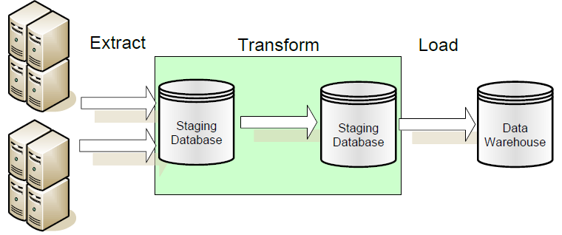
ETL vs. ELT
ETL: Extract, Transform, Load in which data transformation takes place on a separate transformation server.

Slide 41
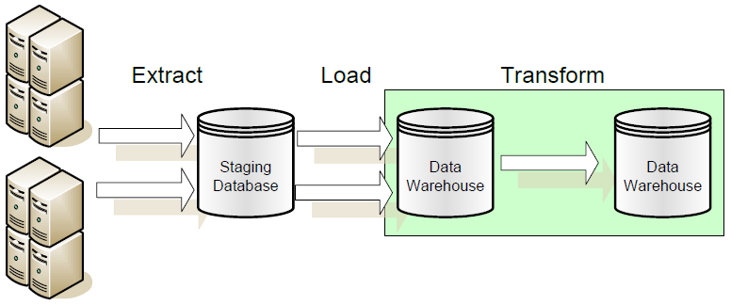
ELT: Extract, Load, Transform in which data transformation takes place on the data warehouse server.

Slide 42
Thank you !!!

